Slide 1
CPSC3300: Computer Systems Organization
Lecture 13 – Branch Hazards and Branch Prediction & Floating-Point Pipeline

Slide 2
Overview
Control hazard and penalty control
Pipeline supporting floating point numbers
Reading
Chp 4.8

Slide 3
What We Learned about Branches
Hardware to reduce branch penalty
Move hardware to examine branch condition and calculate target address early
Both finish at the ID stage of the branch instruction, instead of the EXE stage
Still, there is one instruction delay
A bubble inserted after the branch instruction
How about situations that would cause bubbles before the branch instruction?
Does the branch instruction have dependencies with previous instructions?

Slide 4
Data Hazards for Branches
If a comparison register is a destination of 2nd or 3rd preceding ALU instruction
add $1, $2, $3
IF
ID
EX
MEM
WB
Data forwarding
add $4, $5, $6
IF
ID
EX
MEM
WB
…
IF
ID
EX
MEM
WB
beq $1, $4, target
IF
ID
EX
MEM
WB
Can resolve using forwarding

Slide 5
Data Hazards for Branches
If a comparison register is a destination of preceding ALU instruction or 2nd preceding load instruction
Need 1 stall cycle
lw $1, addr
IF
ID
EX
MEM
WB
add $4, $5, $6
IF
ID
EX
MEM
WB
Bubble inserted
beq stalled
IF
ID
beq $1, $4, target
ID
EX
MEM
WB
This example shows what really happens in HW.
We usually draw with a bubble for five stages and IF moved down to align with the other 4 stages. The effect is equivalent.

Slide 6
Data Hazards for Branches
If a comparison register is a destination of immediately preceding load instruction
Need 2 stall cycles
lw $1, addr
IF
ID
EX
MEM
WB
Bubbles inserted
beq stalled
IF
ID
beq stalled
ID
beq $1, $0, target
ID
EX
MEM
WB

Slide 7
Reducing Branch Penalty
Branch penalty in dynamically scheduled processors: wasted cycles due to pipeline flushing on mis-predicted branches
Reduce branch penalty:
Predict branch/jump instructions AND branch direction (taken or not taken)
Predict branch/jump target address (for taken branches)
Speculatively execute instructions along the predicted path

Slide 8
Branch Direction Prediction
Predict branch direction: taken or not taken (T/NT)
Static prediction
Compiler-determined prediction
Fixed for the life of the program
Dynamic prediction:
The prediction changes as program behavior changes
branch prediction implemented in hardware
common algorithm based on branch history
predict the branch taken if branched the last time
predict the branch not-taken if didn’t branch the last time
BNE R1, R2, L1
…
L1: …
taken
Not taken

Slide 9
A Single Prediction Bit
1. Access
state
2. Predict
Output T/NT
PC
3. Feedback T/NT
1-bit prediction
1: predict T
0: predict NT
The prediction changes with the most recent program behavior
T
NT
NT
1
0
T
1-bit predictor has a low accuracy
General form: finite state machine

Slide 10
Weakness of a Single Prediction Bit
Consider a nested loop of 9 iterations before exit:
For (){
for (i=0; i<9; i++)
a[i] = a[i] * 2.0;
}
How many mispredictions?
2 times:
End of loop case, when it exits instead of looping as before
First time through loop on next time through code, when it predicts exit instead of looping
Only 80% accuracy even if loop 90% of the time

Slide 11
2-bit Branch Prediction for Loops
Algorithm: have to be wrong twice before the prediction is changed
Blue: stop, not taken
Green: go, taken
Adds hysteresis to decision making process
T
NT
Predict Taken
11
10
Predict Taken
T
T
NT
NT
Predict Not
Taken
01
00
Predict Not
Taken
T
NT

Slide 12
Accuracy of Different Schemes (Figure 3.15, p. 206)
4096 Entries 2-bit BHT (Branch History Table)
Unlimited Entries 2-bit BHT
1024 Entries (2,2) BHT
Frequency of Mispredictions

Slide 13
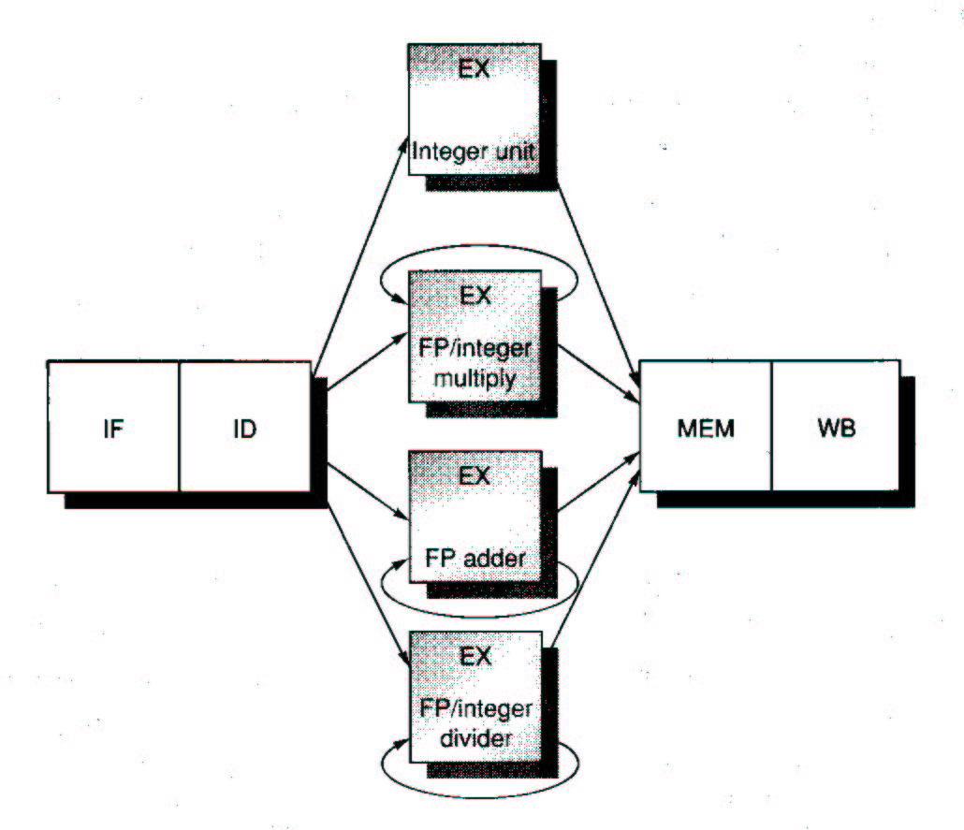
Conceptual view of FP pipeline
The pipeline is for INT
Suppose FP has same pipeline as INT
Two changes
EX may be repeated
Multiple EX FP units
Stalls
structural or data hazards
EX completion of multi-cycle op
Four non-piped functional units
int load/store, ALU ops, branches
FP and int multiply
FP add, sub, conversion
FP int, divide

Slide 14
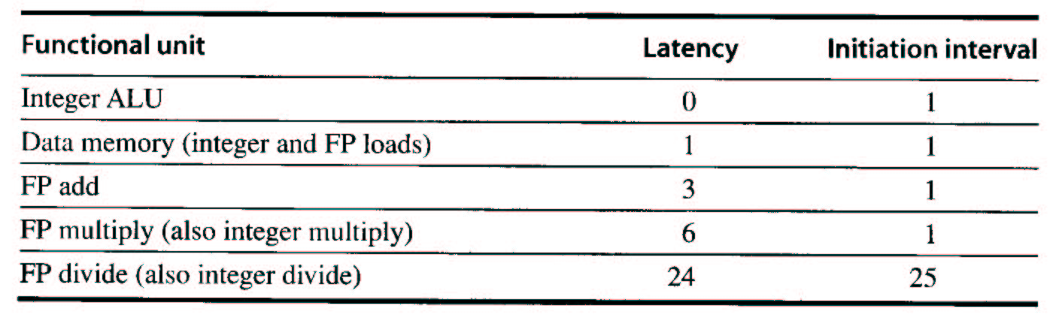
The Execution Pipeline (e.g. Pipelined Functional Units)
Latency
number of intervening cycles between an instruction that produces a result and an instruction that uses the result. Ex:
ALU reg1 op reg2 stored in EX (0);
load reg1 loaded in MEM (1)
Initiation interval
number cycles that must elapse between issuing two ops of a given type

Slide 15
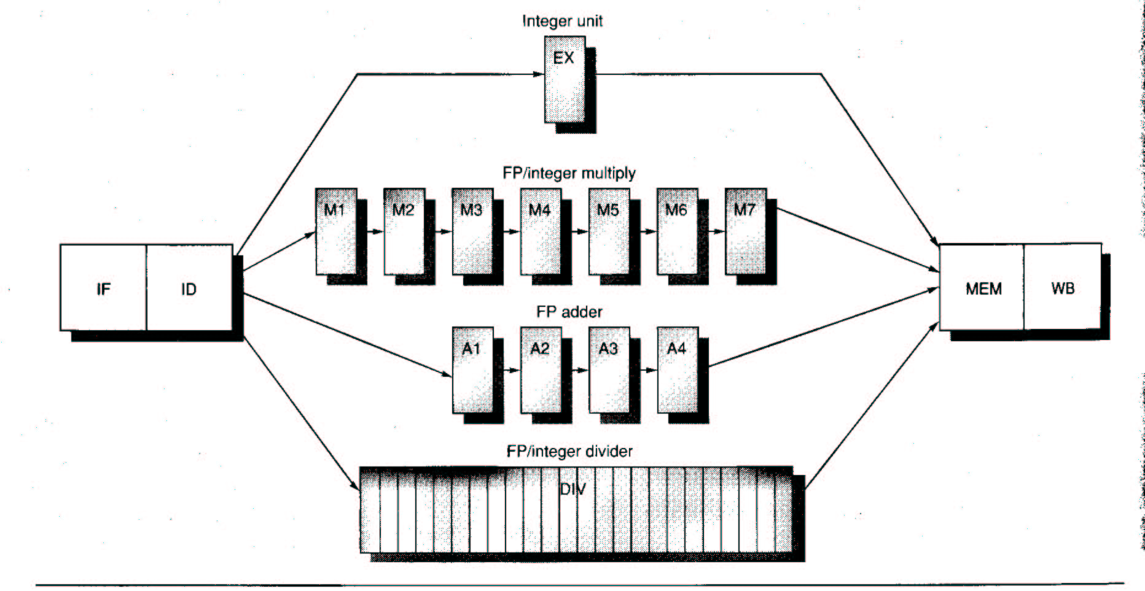
Multiple Outstanding Operations
Pipelined EX unit allows
4 outstanding FP adds
7 outstanding FP/int multiplies
1 outstanding FP divide
stage names
Requires:
Additional temp regs

Slide 16
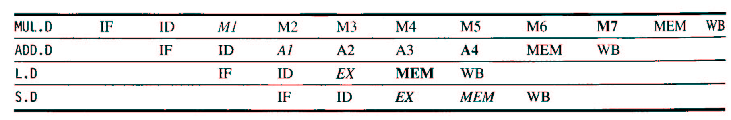
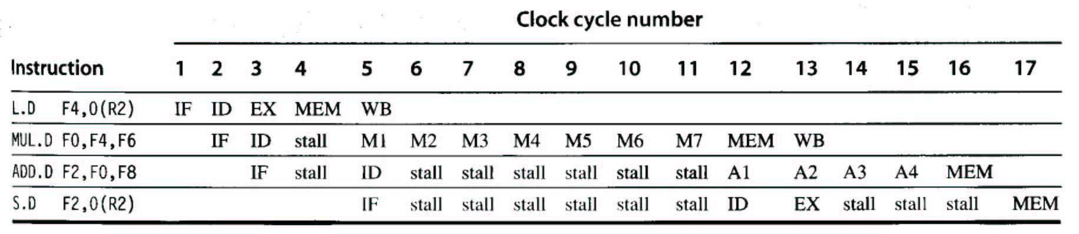
Multi-cycle Example
RAW hazards
If stalled for MUL, stalled for later ins.
Stall even F2’s value available b.c. MEM
used for ADD
If stalled for ADD, stalled for later ins.

Slide 17
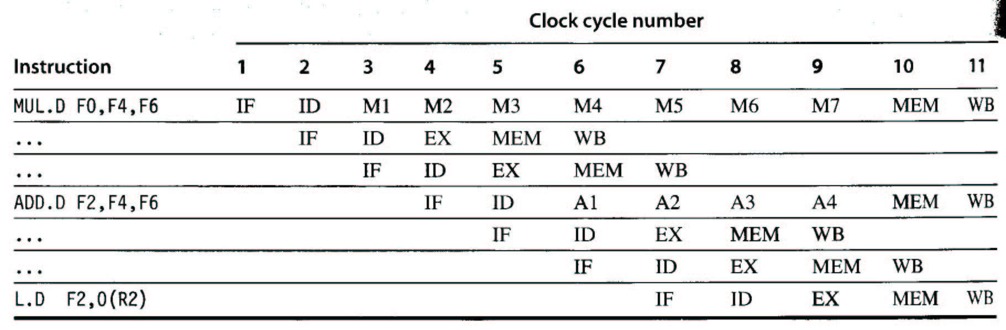
Hazard Detection and Forwarding
Structural hazards
For divides
Multiple reg writes in single cycle can occur (single write port)
Data hazards
Out of order (OOO) completion possible
WAW hazards since WB occur OOO (L.D one cycle earlier + dest F2)
Problems with exceptions
RAW hazards more frequent due to long latency ops

Slide 18
Implementing Hazard Detection and Forwarding
Multiple reg writes in single cycle can occur (single write port)
Multiple write ports, not efficiently used
Track use of write port and stall before issue (ID stage)
WAW hazards since WB occur OOO (out of order)
Delay issue of load
Stamp out result of add.d
Before instruction issue:
Check for structural hazards
Check for RAW hazards
Check for WAW hazards
Conceptually the same to implement, yet more cumbersome

Slide 19
Summary
Branch prediction
Static vs dynamic prediction
BHT (Branch history table)
1-bit vs. 2-bit
Pipeline for FP operations

